Slide 1



Data Types and Variables
Types of Operators
SoftUni Team
Technical Trainers
Software University
https://softuni.bg

Slide 2
Table of Contents
What is data type
Strings
Numbers
Booleans
Additional Data Types
2

Slide 3
Have a Question?
sli.do
#fund-python

Slide 4



What is Data Type
Definition and Examples

Slide 5
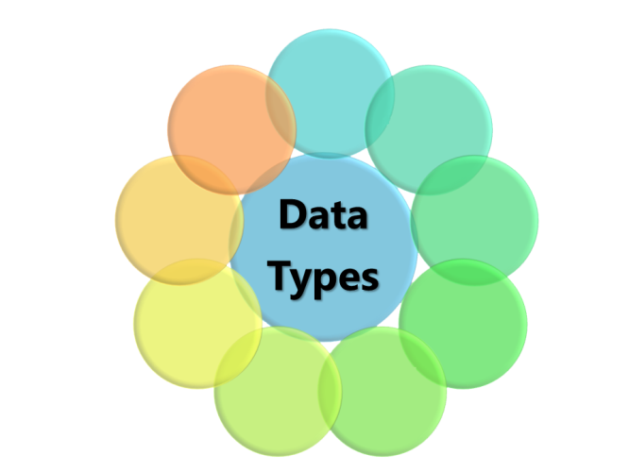
What is Data Type?
A classification that specifies which type of value a variable has and what type of operations can be applied to it
In Python we have the following data types:
Numeric Types: int, float, complex, decimal
Text Type: str
List, Set, Tuple, Dictionary
Boolean
5

Slide 6
Examples
int_num = 10 # int value
float_num = 10.2 # float value
a_str = 'Hello world' # str value
is_true = True # bool value
list = [123, 'abcd', 10.2, 'd'] # list
dict = {'name': 'Amy', 'age': 10} # dictionary

Slide 7
Data Types Are Dynamic
Python is a dynamic language
Variables are not directly associated with any particular value type
Any variable can be assigned (and re-assigned) values of all types
variable = 42 # variable is now an int
variable = 'bar' # variable is now a string
variable = True # variable is now a boolean

Slide 8
Check the Type of a Variable
The type() function helps you find the type of the variable
The isinstance() function checks if the specified object is of the specified type
print(type('123')) # <class 'str'>
print(type(123)) # <class 'int'>
print(type(123==123)) # <class 'bool'>
print(isinstance('123', str)) # True
print(isinstance(123, str)) # False
print(isinstance(123==123, bool)) # True

Slide 9
Strings
'ABC'
Sequence of Characters

Slide 10
What is a String?
Used to represent textual data
Each element in the String occupies a position in the String
The first element is at index 0, the next at index 1, and so on
The length of a String is the number of elements in it
name = 'George'
print(name[0]) #'G'
Accessing element at index
10

Slide 11
String Literal
String literals in Python are surrounded by either single quotation marks or double quotation marks:
'hello' is the same as "hello"
The len() method returns the length of a string
a = "Hello, World!"
print(len(a)) # 13
11

Slide 12

Strings Are Immutable
Unlike in languages like C, Python strings are immutable
This means that once a string is created, it is not possible to modify it
name = 'George'
name[0] = 'P' # Error
12

Slide 13
String Interpolation
From Python 3.6+ we can use string interpolation
These are string literals that allow embedded expressions
name = 'Rick'
age = 18
print(f'{name} = {age}') # Rick = 18
Place your variables inside {}
13

Slide 14
Problem: Concatenate Names
Receive two names as string parameters and a delimiter
Print the names joined by the delimiter
John
Smith
->
Jan
White
<->
John->Smith
Jan<->White
first_name = input()
second_name = input()
delimiter = input()
print(f'{first_name}{delimiter}{second_name}')

Slide 15
Numbers
123
Integer, Float

Slide 16
Integer
Int or integer is a whole number, positive or negative, without decimals, of unlimited length
Python integers are immutable
x = 1 # int
y = 231223423352 # int
z = -2312312 # int
16

Slide 17
Float
Float is a floating-point real number, positive or negative, written with a decimal point dividing the integer and fractional parts, of unlimited length
Python floats are immutable
x = 1.1 # float
y = 231223423352.24 # float
z = -2312312.689 # float
17

Slide 18
Problem: Meters to Kilometers
Write a program that converts meters to kilometers formatted to the second decimal point.
1852
1.85
798
0.80
Notes:
Solution goes to note

Slide 19
Solution: Meters to Kilometers
meters = int(input())
kilometers = meters/1000
print(f'{kilometers:.2f}')

Slide 20
Problem: Pounds to Dollars
Write a program which converts British pounds to US dollars formatted to the 3rd decimal point
1 British Pound = 1.31 Dollars
80
104.800
39
51.090
Notes:
Solution goes to note

Slide 21
Solution: Pounds to Dollars
pounds = int(input())
dollars = pounds * 1.31
print(f'{dollars:.3f}')

Slide 22
Problem: Centuries to Minutes
Write a program to enter an integer number of centuries and convert it to years, days, hours and minutes
Centuries = 1
1 centuries = 100 years = 36524 days = 876576 hours = 52594560 minutes

Slide 23
Solution: Centuries to Minutes
centuries = int(input())
years = centuries * 100
days = int(years * 365.2422)
hours = 24 * days
minutes = 60 * hours
print(f"{centuries} centuries = {years} years = {days} days = {hours} hours = {minutes} minutes")
Tropical year has 365.2422 days
int() converts float to int
23

Slide 24
Booleans
True False
Conditions

Slide 25
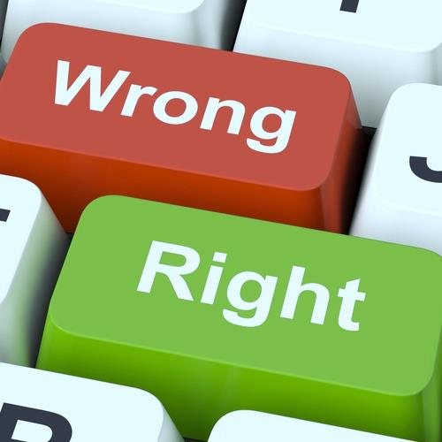
What is a Boolean?
Boolean represents a logical entity and can have two values: True and False
You can use the bool() function to find out if an expression (or a variable) is true:
Or even easier:
print(bool(10 > 9)) # True
print(10 > 9) # True
25

Slide 26
Comparisons and Conditions
Operator | Description | Example
== | equal | if (day == 'Monday')
> | greater than | if (salary > 9000)
< | less than | if (age < 18)
>= | greater than or equal | if (6 >= 6)
!= | not equal | if (5 != 5)
in | item is in sequence | 'a' in 'abc' # True

Slide 27
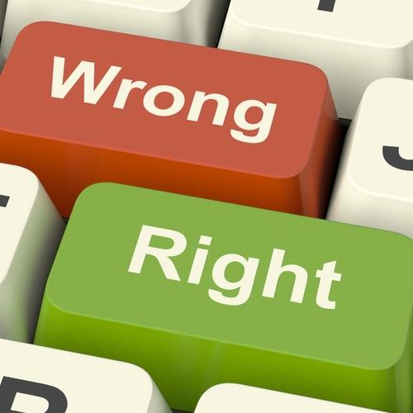
Booleans Examples (1)
Everything with a "value" is True
Everything without a "value" is False
number = 1
if (number):
print(number) # 1
True
number = None
if (number):
print(number)
else:
print('false') # False
False

Slide 28

Booleans Examples (2)
x = 0
bool(x) # False
x = -0
bool(x) # False
x = ''
bool(x) # False
x = False
bool(x) # False
x = None
bool(x) # False

Slide 29
Problem: Special Numbers
Write a program which reads an integer n. For all numbers in the range 1…n print the number and if it is special or not (True / False)
A number is special when the sum of its digits is 5, 7 or 11
1 -> False
2 -> False
3 -> False
4 -> False
5 -> True
6 -> False
7 -> True
8 -> False
9 -> False
10 -> False
11 -> False
12 -> False
13 -> False
14 -> True
15 -> False
16 -> True
17 -> False
18 -> False
19 -> False
20 -> False
20
Notes:
Solution goes to note

Slide 30
Solution: Special Numbers
n = int(input())
for num in range(1, n + 1):
sum_of_digits = 0
digits = num
while digits > 0:
sum_of_digits += digits % 10
digits = int(digits / 10)
# TODO: check whether the sum is special

Slide 31
Problem: Next Happy Year
Happy Year is the year with only distinct digits
for example, 2018
Write a program that receives an integer number and finds the next happy year
8989
9012
1001
1023
Notes:
Solution goes to note

Slide 32
Additional Datatypes
[] {}
List, Tuple, Set, Dict

Slide 33
Definition and Examples (1)
A list contains items separated by commas and enclosed within square brackets
A tuple is a collection which is ordered and unchangeable. In Python tuples are written with round brackets
cars = ["Saab", "Volvo", "BMW"]
example_tuple =("apple", "banana", "cherry") print(example_tuple)
33

Slide 34
Definition and Examples (2)
A set is a collection which is unordered and unindexed. Sets are written with curly brackets.
A dictionary is a collection which is ordered (python 3.7+), changeable and indexed
They have keys and values
example_set = {"apple", "banana", "cherry"}
print(example_set)
example_dict = {"brand": "Ford", "model": "Mustang"}
print(example_dict)
34

Slide 35
None Keyword
None

Slide 36
What is None?
The None keyword is used to define a null value or no value at all
There are two ways to check if a variable is None
One way can be performed by using the is keyword
Another is using the == syntax
if null_variable is None:
print('null_variable is None')
if null_variable == None:
print('null_variable is None')
36

Slide 37
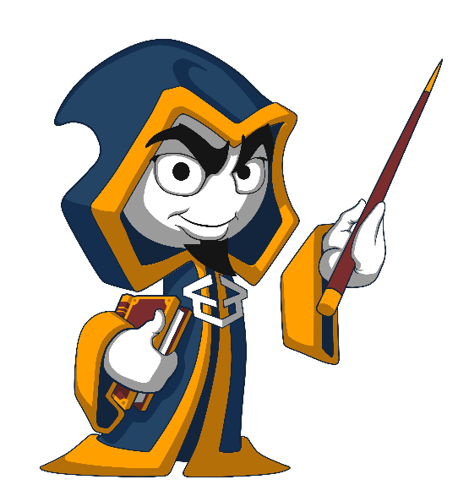
Summary
…
…
…
Python supports the following data types:
String
Bool
Int
Float
List, Tuple, Set, Dict
None is nothing

Slide 38
Questions?
Notes:
38

Slide 39














SoftUni Diamond Partners

Slide 40

Educational Partners

Slide 41
Trainings @ Software University (SoftUni)
Software University – High-Quality Education, Profession and Job for Software Developers
softuni.bg, softuni.org
Software University Foundation
softuni.foundation
Software University @ Facebook
facebook.com/SoftwareUniversity
Software University Forums
forum.softuni.bg
41
Notes:
41

Slide 42

License
This course (slides, examples, demos, exercises, homework, documents, videos, and other assets) is copyrighted content
Unauthorized copy, reproduction or use is illegal
© SoftUni – https://about.softuni.bg
© Software University – https://softuni.bg
Notes:
42

